Slide 1
Sources of Our Faith
Dr. Hratch Tchilingirian

Slide 2
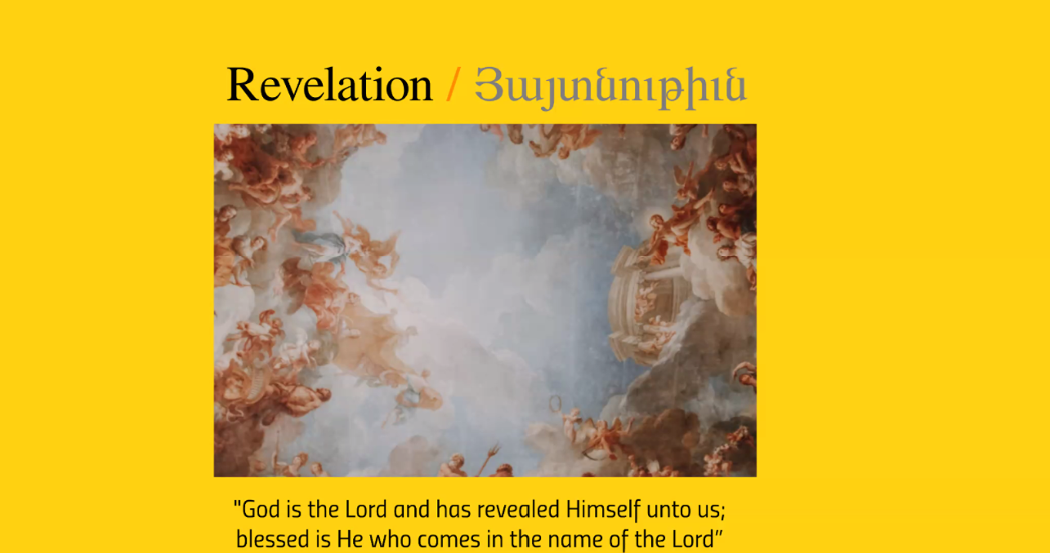

Slide 3
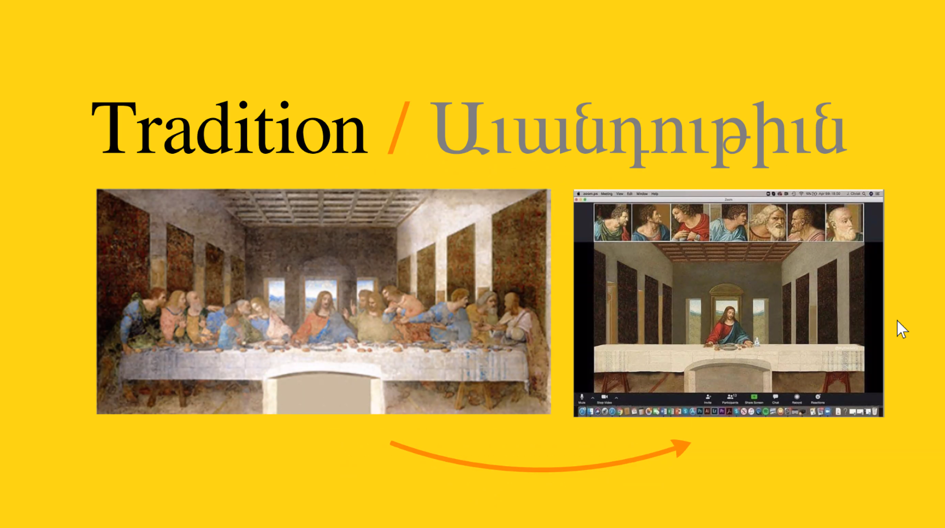

Slide 4
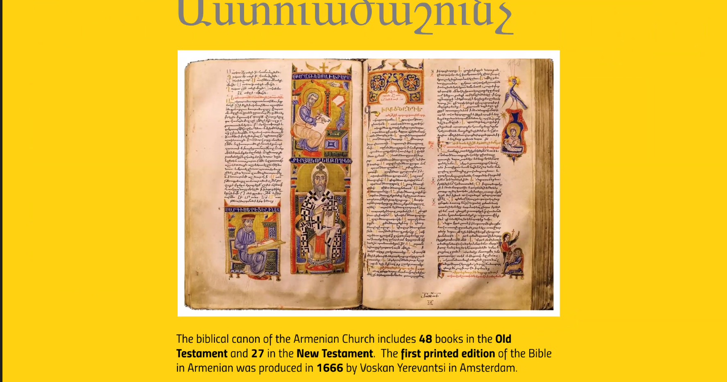

Slide 5


Slide 6


Slide 7
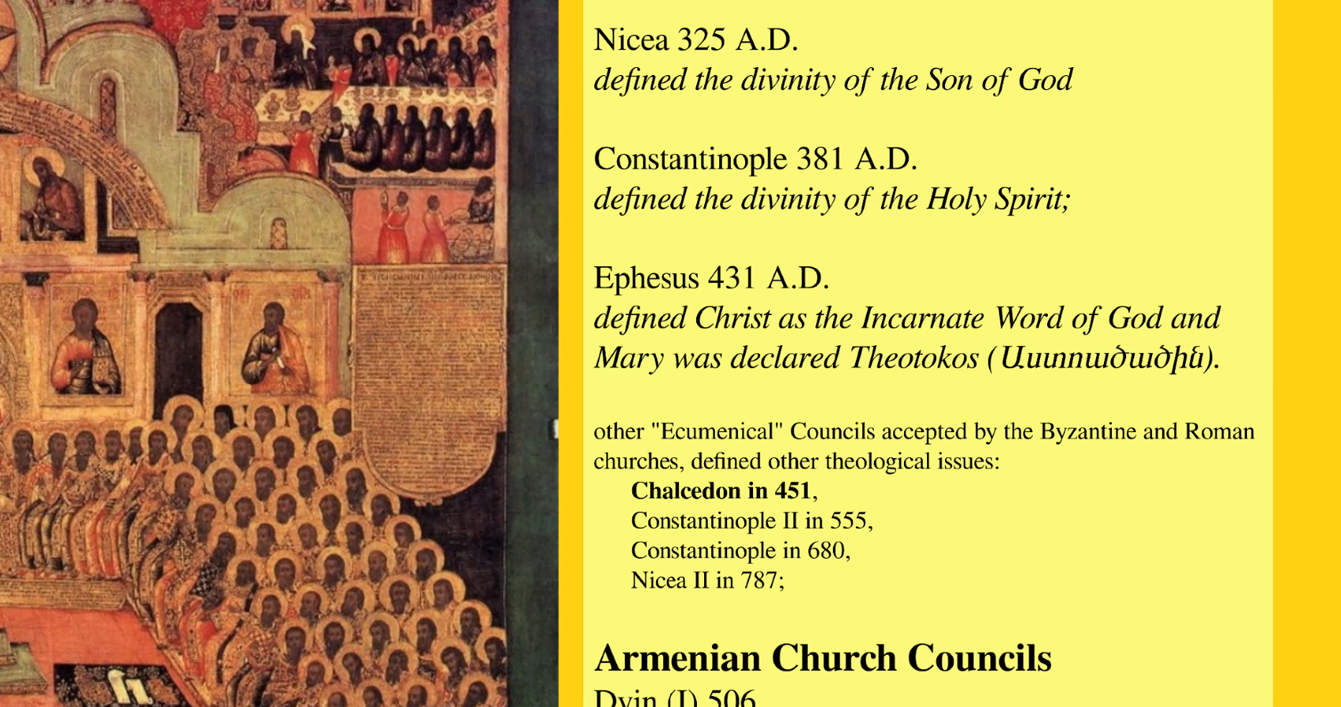

Slide 8
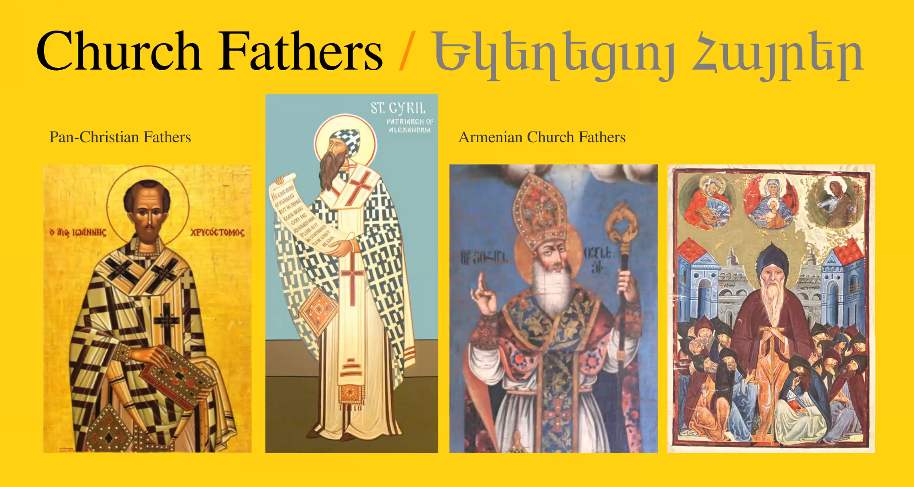

Slide 9


Slide 10


Slide 11


