Slide 1
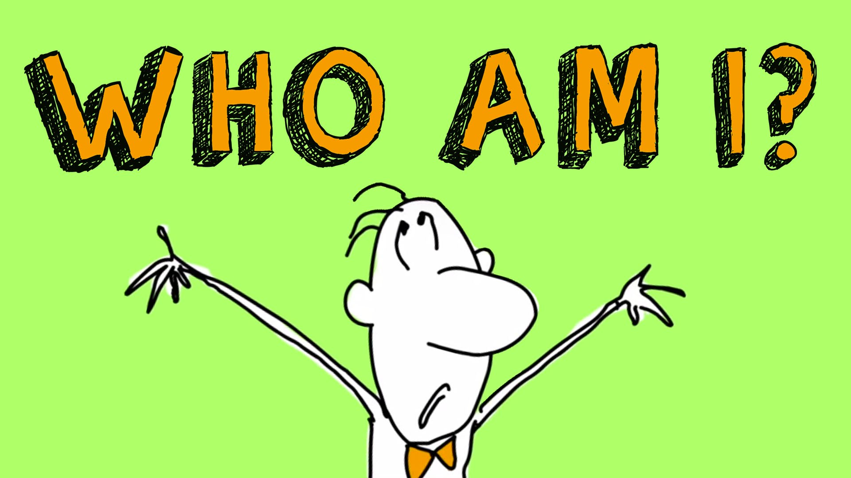
Identity

Slide 2
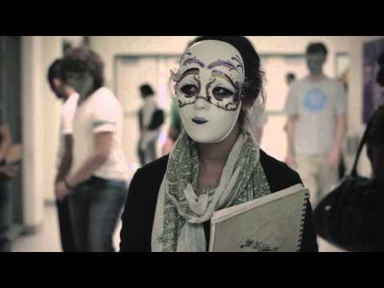
Identity SHORT FILM (Award Winning Inspirational Short)
Notes:
The video starts out with a girl in the bathroom wearing a mask, that is broken. The film rewinds itself until this girl is sitting alone at table during lunch. The video proceeds to go through the school day in class, throughout the halls, chess club, and lunch time. As you watch the video you notice that all the students in the school wear masks. At one point in the hallway scene, you see a beauty ad that shows a model in a yellow masks with all of these girls admiring the ad with yellow masks. Another scene in the hallway shows a student walking down the hall with a lavender designed masks and walks up to a group with all maroon masks and switches her mask to maroon. Even the dialogue in the film is powerful. At the end of the film, the main character is in the bathroom, where the film started.

Slide 3
DISCUSSION
Why do you think everyone was wearing a mask?
What was happening in the film?
What did the yellow masks mean?

Slide 4
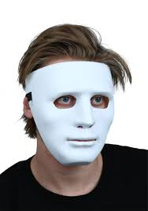
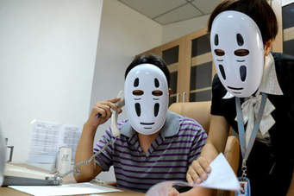
DISCUSSION
DO YOU EVER FEEL LIKE YOU’RE WEARING A MASK?

Slide 5
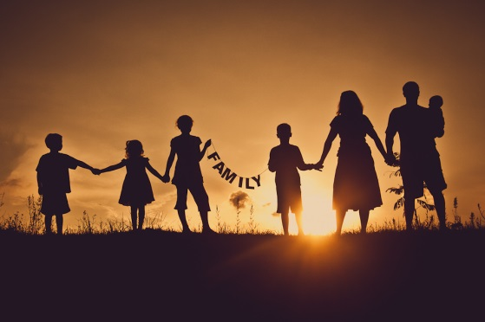
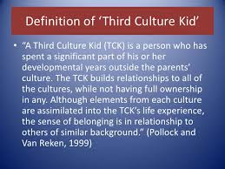
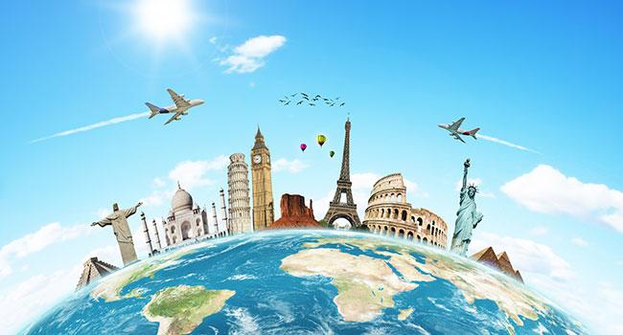
Me in Pictures!
Every person is different – that’s why the world is so unique!
YOUR TASK – Draw three pictures / symbols, or find three images online that represent you and your culture and lifestyle.
E.g. The following images represent your teacher.
Loves Family TCK Travel
Notes:
You should allow some time for students to either draw or get online to find three images that REPRESENT them. As their advisor, you should find three images that represent you and insert them into this slide. You should use this as an example for students as you explain the task to them. The above images are three images that I chose to represent myself. After the task is complete, you should ask students to share their images and explain why they chose those particular images.

Slide 6
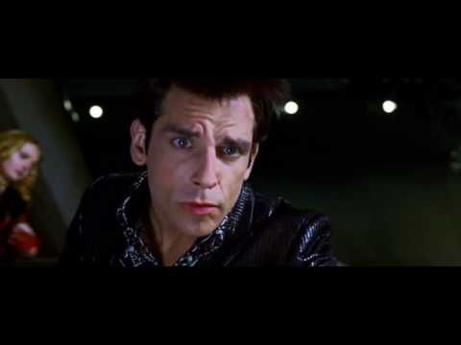
WHO ARE YOU?

Slide 7
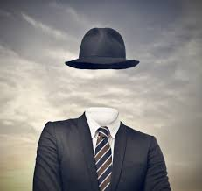
WHAT is IDENTITY?
(A DISCUSSION)
THE CONDITION OF BEING ONESELF, AND NOT ANOTHER
WHAT DO YOU THINK SHAPES YOUR IDENTITY?
Throughout your life you will belong to many different groups and communities.These different groups and
communities help shape and define your own identity.

Slide 8
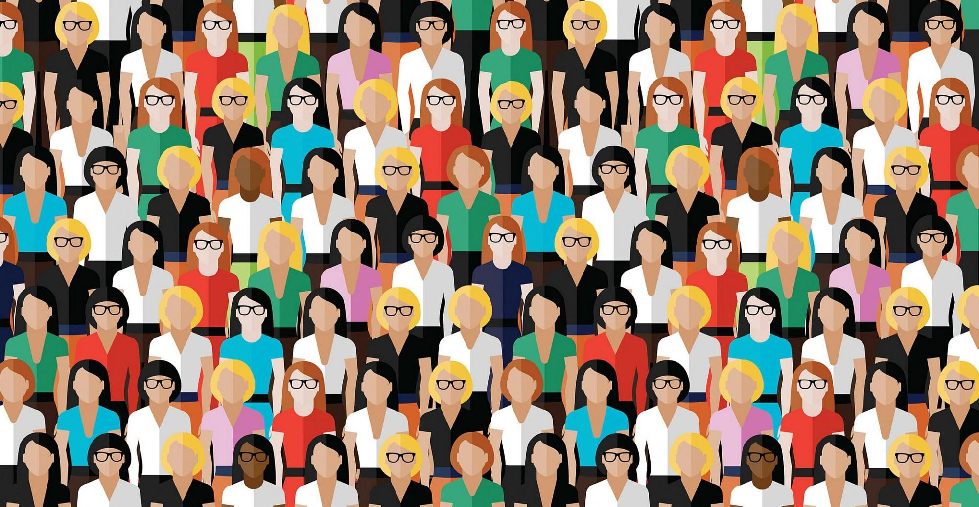
What groups do we belong to?
AN ACTIVITY...
See how many different groupings you can form in this class.
These could be based on gender, hair color, beliefs,background, taste in music – or anything else you like!

Slide 9

FOUR CORNERS
Listen to the following statements and decide if you strongly agree, agree, disagree, or strongly disagree with them. Choose the appropriate corner of the room. Be ready to support your decisions!
Notes:
Label each corner of your room as strongly agree, agree, disagree, or strongly disagree. After each statement is read, ask students to move to the corner that best represents them. Follow each statement with a discussion.

Slide 10
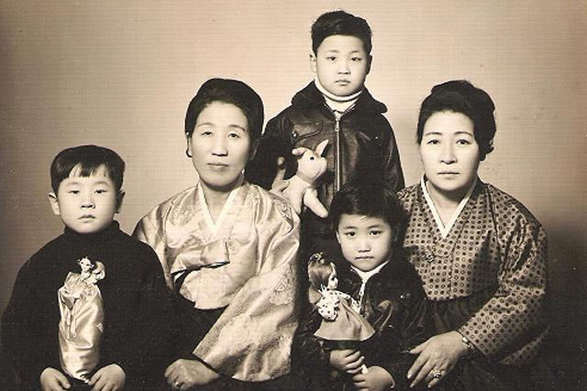
FOUR CORNERS
Most of my values and beliefs stem from what my family has taught me to be important.

Slide 11
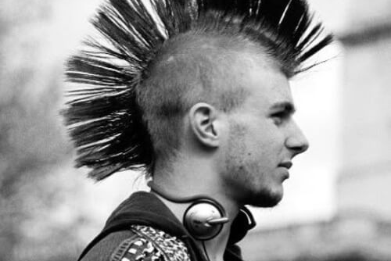
FOUR CORNERS
You can usually figure out a person’s identity by looking at their appearance.

Slide 12
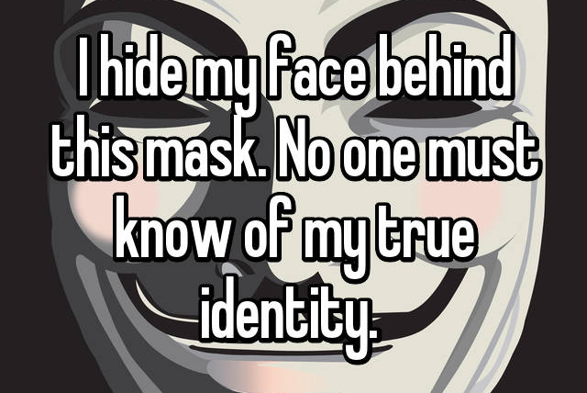
FOUR CORNERS
My true identity is not the same as what others might perceive it to be.

Slide 13
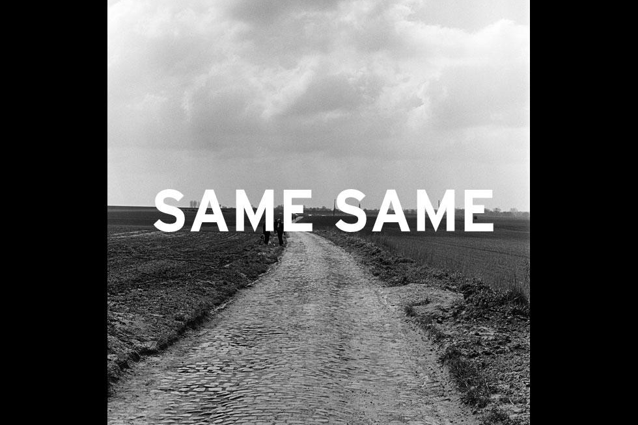
FOUR CORNERS
A person’s identity stays the same throughout his/her life.

Slide 14
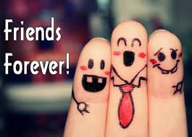
FOUR CORNERS
You can learn a lot about someone by their friendships.

Slide 15
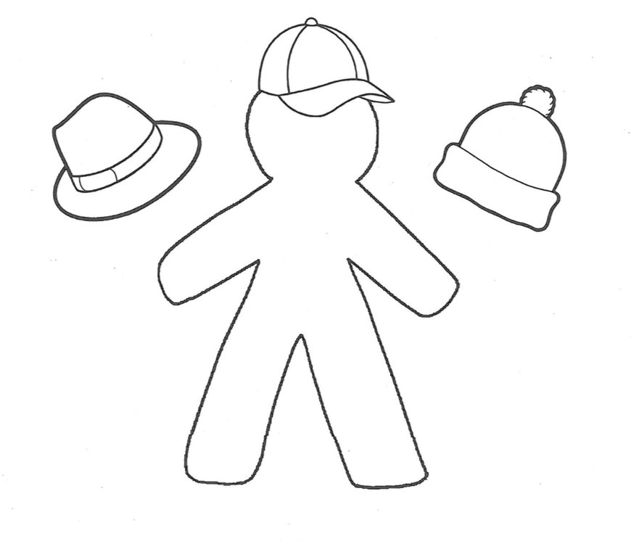
A Wearer of Many HATS
Notes:
Draw a similar body outline in your books and add wordsto it that you think describe your identity. These words might be adjectives that describe your personality, or nouns that name institutions, places, or objects that you associate yourself with.
Choose the three roles you fill that you think most define you. Some examples of roles include: student, son/daughter, brother/sister, athlete, artist, friend, American, etc.

